Slide 1
Template Guide
(codelabor-struts1-template)
2009. 01. 05
CODELABOR
Shin Sang Jae (codelabor@gmail.com)

Slide 2
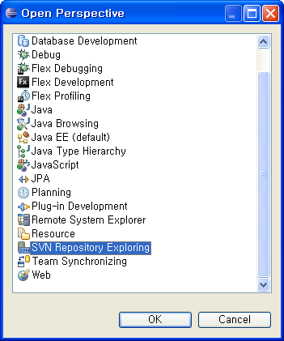
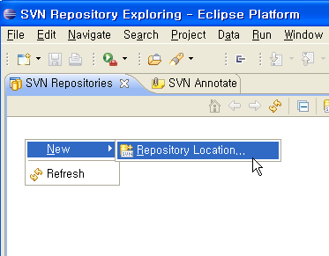
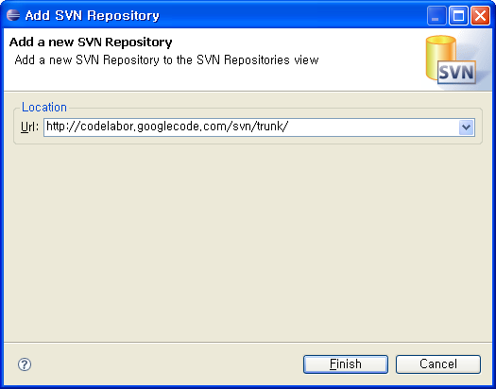
Project Template
Repository
SVN URL: http://codelabor.googlecode.com/svn/trunk/

Slide 3
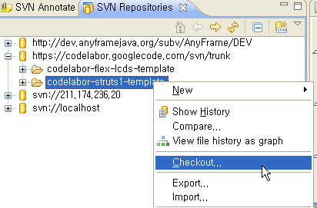
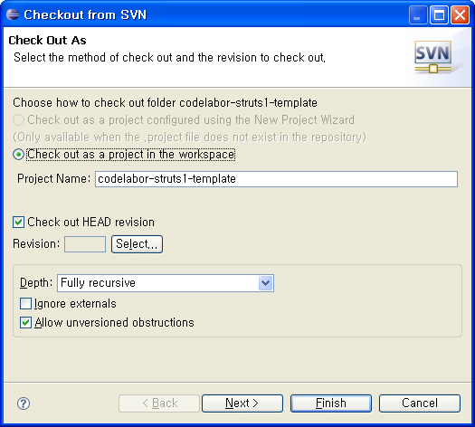
Project Template
Checkout
Checkout Project

Slide 4
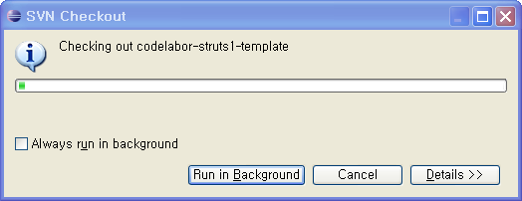
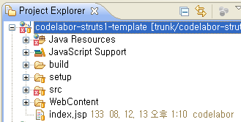
Project Template
Import
Import Project

Slide 5
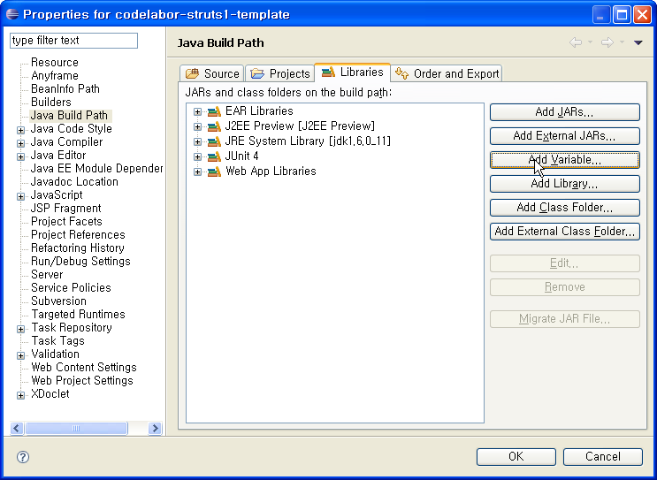
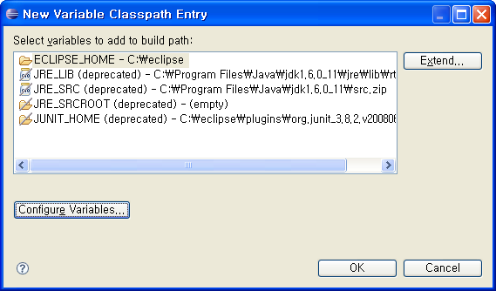
Project Template
Jeus Library
Add Classpath Variable

Slide 6
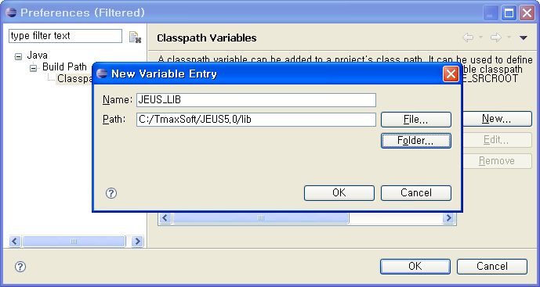
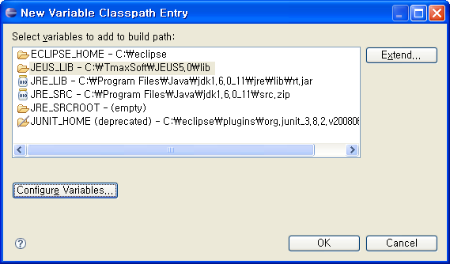
Project Template
Jeus Library
Variable Name: JEUS_LIB
Variable Path: C:/TmaxSoft/JEUS5.0/lib

Slide 7
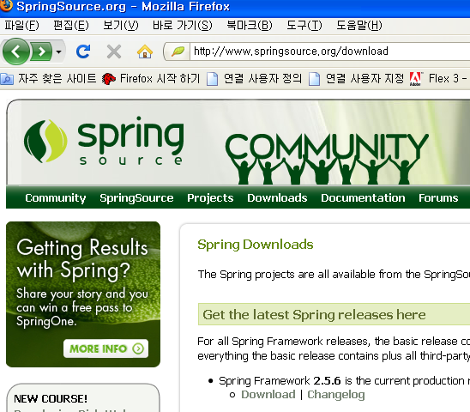
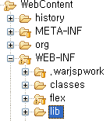

Project Template
Spring Library
Official Site URL: http://www.springframework.org/
Download Site URL: http://www.springsource.org/download
Download File: spring-framework-2.5.6.zip
Unzip File
Copy Files: spring-framework-2.5.6/dist/modules/*.*
Destination Directory: C:\workspace\codelabor-struts1-template\WebContent\WEB-INF\lib

Slide 8
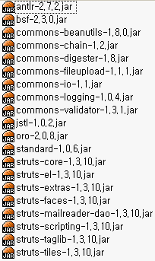
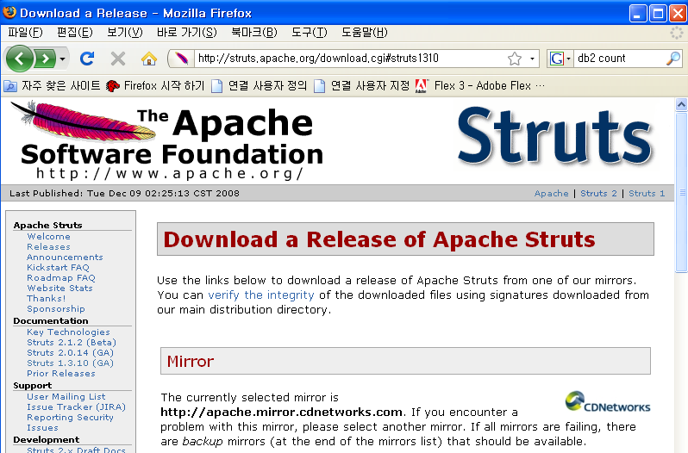

Project Template
Struts Library
Official Site URL: http://struts.apache.org/1.3.10/index.html
Download Site URL: http://struts.apache.org/download.cgi#struts1310
Download File: struts-1.3.10-all.zip
Unzip File
Copy Files: struts-1.3.10/lib/*.*
Destination Directory: C:\workspace\codelabor-struts1-template\WebContent\WEB-INF\lib

Slide 9
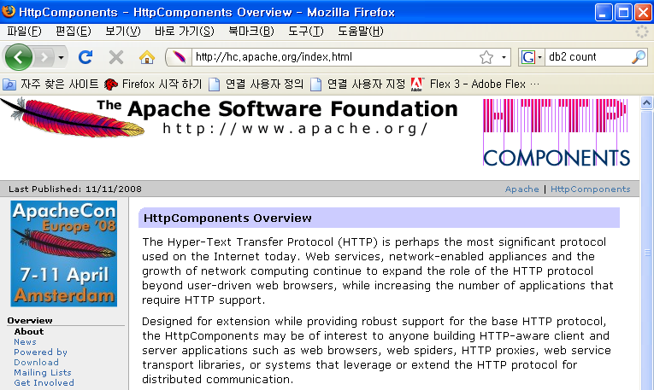

Project Template
HttpClient Library
Official Site URL: http://hc.apache.org/
Download Site URL: http://hc.apache.org/downloads.cgi
Download File: commons-httpclient-3.1.zip
Unzip File
Copy Files: commons-httpclient-3.1.jar
Destination Directory: C:\workspace\codelabor-struts1-template\WebContent\WEB-INF\lib

Slide 10
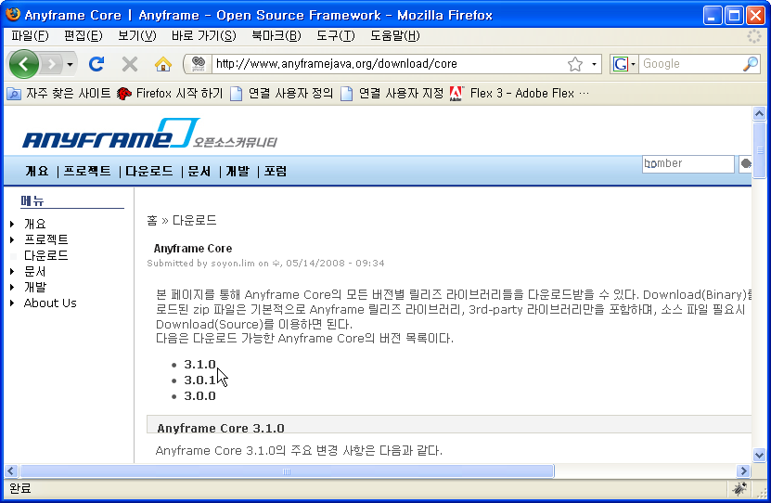

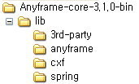
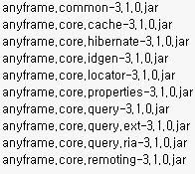
Project Template
Anyframe Library
Official Site URL: http://www.anyframejava.org
Download Site URL: http://www.anyframejava.org/download/core#310
Download File: Anyframe-core-3.1.0-bin.zip
Unzip File
Copy Files: Anyframe-core-3.1.0-bin\lib\anyframe\*.*
Make Directory: C:\workspace\codelabor-struts1-template\WebContent\WEB-INF\lib
Destination Directory: C:\workspace\codelabor-struts1-template\WebContent\WEB-INF\lib

Slide 11
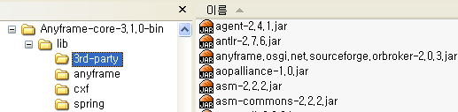
Project Template
Anyframe 3rd-Party Library
Official Site URL: http://www.anyframejava.org
Download Site URL: http://www.anyframejava.org/download/core#310
Download File: Anyframe-core-3.1.0-bin.zip
Unzip File
Copy Files: Anyframe-core-3.1.0-bin\lib\3rd-party\*.*
Destination Directory: C:\workspace\codelabor-struts1-template\WebContent\WEB-INF\lib

Slide 12
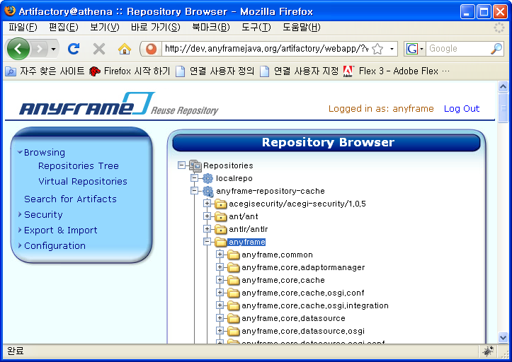
Project Template
Anyframe Patch Library
Official Site URL: http://www.anyframejava.org
Download Site URL: http://dev.anyframejava.org/artifactory
Username: anyframe
Password: anyframe0
Browse repository tree: anyframe-repository-cache/anyframe/

Slide 13
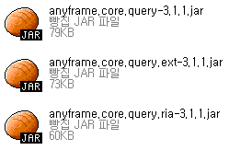
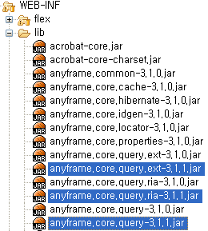
Project Template
Anyframe Patch Library
Download File:
  anyframe.core.query-3.1.1.jar
  anyframe.core.query.ext-3.1.1.jar
  anyframe.core.query.ria-3.1.1.jar
Destination Directory: C:\workspace\codelabor-struts1-template\WebContent\WEB-INF\lib

Slide 14
Project Template
Unused Library
Delete File:
  antlr-2.7.2.jar
  anyframe.core.query-3.1.0.jar
  anyframe.core.query.ext-3.1.0.jar
  anyframe.core.query.ria-3.1.0.jar
  commons-beanutils-1.7.0.jar
  commons-digester-1.7.jar
  junit-3.8.1.jar

Slide 15
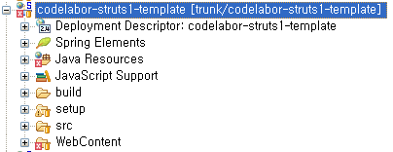
Project Template
Directory Overview
Perspective: Java EE
Java source directory
TestCase output directory
Ant build file directory
Web content directory

Slide 16
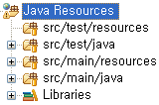
Project Template
Java Source Directory 1/2
Non java source directory for TestCase
Java source directory for TestCase
Non java source directory
Java source directory

Slide 17
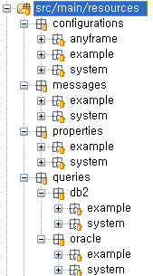
Project Template
Java Source Directory 2/2
Application context directory for anyframe
Application context directory for example
Application context directory for system
Message directory for example
Message directory for system
Queries directory for example (DB2)
Queries directory for system (DB2)
Queries directory for example (Oracle)
Queries directory for system (Oracle)

Slide 18
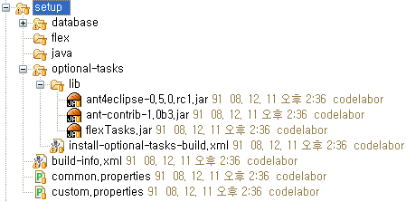
Project Template
Setup Directory 1/2
Ant build file directory for database setup
Ant build file directory for mxmlc (Flex)
Ant build file directory for javac (Java)
Ant build file directory for optional task setup
Ant task jar directory
Ant build file for optional tasks installation
Ant build file for prompt system environment
Ant build file for common configuration
Ant build file for custom configuration

Slide 19
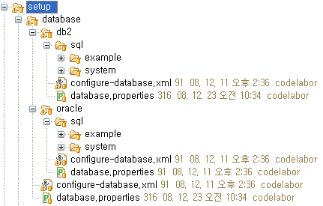
Project Template
Setup Directory 2/2
SQL file directory for example (DB2)
SQL file directory for system (DB2)
Ant build file for database setup (DB2)
Properties file for database setup (DB2)
Ant build file for database setup (Common)
Properties file for database setup (Common)

Slide 20
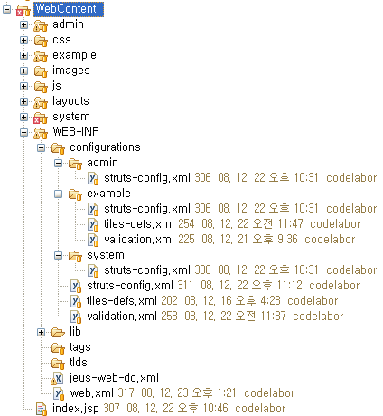
Project Template
Web Content Directory
CSS directory
Images directory
Java script directory
Layout directory (Tiles / Frameset)
Configuration directory (Struts)
Web library directory
Tags directory
TLD directory

